Slide 1
INTRODUCTION TO COMPUTER NETWORKS

Slide 2
Definition
Two or more computers linked or connected together for the purpose of communicating and sharing information and other resources e.g. printers, scanners etc.
Computers on a network may be linked through cables, telephone lines, radio waves, satellites, or infrared light beams.

Slide 3
Examples of activities requiring networks
Teleworking or Telecommuting
  Making use of networking technology to allow working at different locations while keeping in touch with co-workers.
Electronic Trading
  Organisations and their customers making use of networks as a means for advertising, buying and selling goods and services.
Tele and video conferencing
  Groups of people conducting meetings via a telephone or video network.

Slide 4
Groups of Networks
LAN
WAN
MAN
PAN

Slide 5
Local Area Networks (LAN)
Privately owned networks that offer reliable high speed communications for interconnecting equipment in a limited geographical area.
  e.g. within an office, a building or a complex of buildings within a campus.
Do not require external network services e.g. telephone network or leased data lines.
LAN is a private network.
LANs used by companies are called enterprise networks.
LAN are widespread as a result of:
  Increasing need to transfer data between computers within the organisation.

Slide 6
Purpose of LAN
LANs allow:
  Data transfer between computers
  Access to data stored somewhere
  Messages to be passed between computers
  Shared use of peripherals e.g. printers
  Shared use of computing resources

Slide 7
Wide Area Networks (WAN)
Covers a large geographical area to provide national and international communication.
Some are specifically designed:
  to transfer analogue signals e.g. speech
  To transfer digital information e.g. computer data
Connections require the use of telephone lines, ISDN (Integrated Services Digital Network) lines, radio waves, cable, or satellite links.
WANs can be accessed through dial-up connections, using a modem or leased-line direct connection.

Slide 8
Metropolitan Area Network (MAN)
Similar to LAN but spans an entire city or region;
Formed by connecting multiple LANs, therefore larger than LANs but smaller than Wide Area Networks (WAN).
Used to build networks with high data connection speeds for cities, towns or region.
Interconnect computer systems and peripheral devices but over a wider geographical area than LAN
High speed networks for voice, data and video for public or private communications systems within a specified geographical area (city, town or region).
Covers a geographical area of up to 100 km.

Slide 9
Why use MAN
Two categories of MAN users:
  Individual users who wish to access external networked services or to connect to their office from home.
  Companies that need to interconnect LANs based on sites spread across a limited geographical area.
  MAN offers users a cost effective way of providing such access at high data rates than making use of WAN services.

Slide 10
Personal Area Network (PAN)
Refers to interconnection of information technology devices or gadgets within the environment of an individual user.
Interconnected devices might include laptop computers, PDAs, cellphones, printers, PCs.
Also known as a wireless personal network (WPAN).

Slide 11
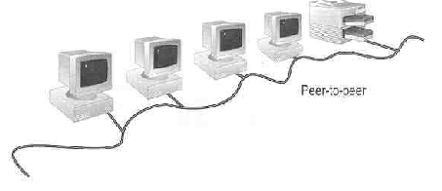
Types of Networks
Peer-to-peer network
Each computer acts as either a server or a client, depending on the user's needs.
Each user or workstation establishes its own security and determines which resources are available to other users.
These networks are limited in size.
Peer-to-peer network is also called workgroup
No hierarchy among computers ⇒ all are equal
No administrator responsible for the network
Software packages for peer-to-peer include Windows XP, 7, 8, Novell's NetWare, UNIX, and Ubuntu 14.4 LTS Desktop

Slide 12
Advantages of peer-to-peer networks:
  Low cost
  Simple to configure
  User has full accessibility of the computer
Disadvantages of peer-to-peer networks:
  May have duplication in resources
  Difficult to uphold security policy
  Difficult to handle uneven loading
Where peer-to-peer network is appropriate:
  10 or less users
  No specialized services required
  Security is not an issue
  Only limited growth in the foreseeable future

Slide 13
Clients and Servers
  Network Clients (Workstation)
    Computers that request network resources or services from the sever.
  Network Servers
    Computers that manage and provide network resources and services to clients.
      Usually have more processing power, memory and hard disk space than clients
      Run Network Operating System that can manage not only data, but also users, groups, security, and applications on the network
      Servers often have a more stringent requirement on its performance and reliability
      Server operating systems are Microsoft Server 2008, 2012, Novell's NetWare, Ubuntu 12.4 Server LTS etc.
      A secure environment suitable for most organizations.

Slide 14
Advantages of client/server networks
  Facilitate resource sharing – centrally administrate and control
  Facilitate system backup and improve fault tolerance
  Enhance security – only administrator can have access to Server
  Support more users – difficult to achieve with peer-to-peer networks
Disadvantages of client/server networks
  High cost for Servers
  Need expert to configure the network
  Introduce a single point of failure to the system

Slide 15
Other networks
Intranet
A private network controlled by an organization to encourage interaction among its members, improve efficiency and share information.
Information and resources that are shared on an intranet might include: organizational policies and procedures, announcements, information about new products, and confidential data of strategic value.
Extranet
An extranet is an extended intranet.
In addition to allowing access to members of an organization, an extranet allow access to users from outside the organization.
An extranet is a private network that uses Internet to share resources with customers, suppliers, vendors, partners, or other businesses.
Both intranets and extranets are owned, operated and controlled by one organization.
The difference between intranets and extranets is defined in terms of who has access to the private network and the geographical reach of that network.
Intranets allow only members of the organization to access the network, while an extranet allows persons from outside the organization (i.e. business partners and customers) to access the network.
Network access is managed through the administration of usernames and passwords, which are also used to determine which parts of the extranet a particular user can access.

Slide 16
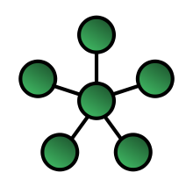
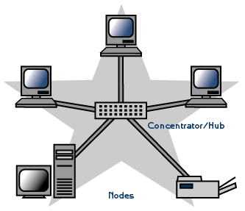
Star Topology
Individual links radiate out from a central point
Each device has its own cable or dedicated link that runs from a central controller or other device.
All routing of traffic is performed by this central node, relieving the outlying nodes of control functions.
Simple point to point links are used, eliminating the need for complex link and control requirements.
A major disadvantage is that the central controller is a single point of failure. If it fails, so does the entire network.
    More cabling, hence higher cost.
    Depending on the intelligence of hub, two or more computers may send message at the same time

Slide 17
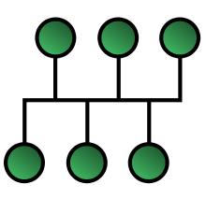
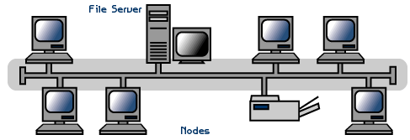
Bus Topology
All devices are connected to a single linear cable called a trunk (also known as a backbone or segment).
Most frequently used for distributing control in LANs.
Messages transmitted will arrive at all other nodes, each of which requires the ability to recognise its own address in order to receive messages.
Nodes do not have to repeat and forward messages intended for others.
Both ends of the cable must be terminated to stop the signal from bouncing.
Difficult to troubleshoot than a star network because the network does not have a central point.
A break or problem at any point along the bus can cause the entire network to go down.
    Only one computer can send messages at a time

Slide 18
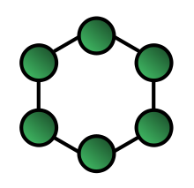
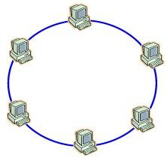
Ring Topology
Nodes connected by point to point, links are arranged in an unbroken circular configuration or ring.
Messages are transmitted from node to node.
Each node must be capable of recognizing its own address to accept messaged destined for it and to ignore messages destined for other addresses.
Each node must also serve as a repeater and re-transmit any messages it receives that are addressed to other nodes.
There are no terminating ends; therefore, if one computer fails, the entire network will go down.
Difficult to add computers and More expensive
This type of network is commonly called a token ring network.
  only the computer who gets the token can send data.

Slide 19
When configuring ring networks:
They must be fully connected.
Links have to be placed between a new node and the adjacent nodes for each node addition.
It is difficult to pre-wire a building in anticipation of nodes to be added.
Failure of a node, adding of a node or any other break causes the network to fail.
Steps can be taken to bypass a failure point but this can increase the complexity of each node.

Slide 20
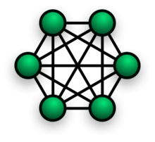
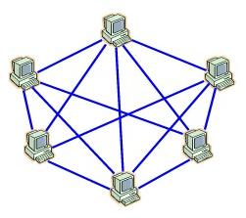
Mesh Topology
Used to connect locations on a many to many basis.
Resilient to link failures as alternative data routes may be available depending upon the routing capabilities of the intervening nodes
Expensive to implement and require sophisticated control or management systems.

Slide 21
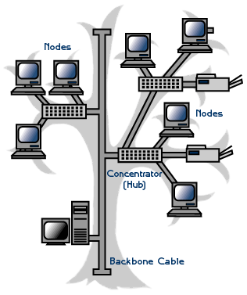
Tree or Hierarchical Topology
Can provide a combination of both central and distributed control.
Consist of a central point from which a number of links emanate, providing a structure like the branch of a tree.
Intelligent devices are used to control the traffic flow at each branch point.
Control of resources can be distributed thus alleviating a large part of the workload on one central controller.
A popular topology for WANs due to long distances involved and the ability to distribute control functionality.
Also common in modern LANs, based on the use of structured wiring approaches.

Slide 22
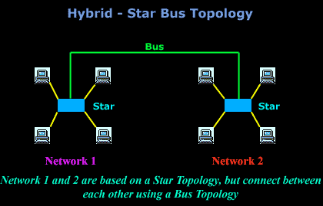
Hybrid topologies
Incorporating two or more of the basic topologies.
E.g. a company network connecting a number of remote locations using a Tree based WAN.
Operation and control of a network can be complicated and expensive
However, the flexibility and efficiencies offered may outweigh the risks and costs involved.

Slide 23
Advantages and disadvantages of networks
Advantages
Sharing devices such as printers saves money.
Software licences are cheaper than buying several standalone licences.
Files can easily be shared between users.
Communication by email and instant messenger.
Security is good - users cannot see other users' files unlike on stand-alone machines.
Data is easy to backup as all the data is stored on the file server.

Slide 24
Disadvantages
Purchasing the network cabling and file servers can be expensive.
Managing a large network is complicated, requires training and a network manager usually needs to be employed.
If the file server breaks down the files on the file server become inaccessible. Email might still work if it is on a separate server. The computers can still be used but are isolated.
Viruses can spread to other computers throughout a computer network.
There is a danger of hacking, particularly with wide area networks. Security procedures are needed to prevent such abuse, eg a firewall.

